Slide 1




Databases
Database Query Methods
SoftUni Team
Technical Trainers
Software University
http://softuni.bg

Slide 2

Table of Contents
What is SQL?
Connecting to a SQL Server Database
What are SQL Queries?
Working with SQL Queries
CRUD Operations in SQL
Working with Stored Procedures
Parameterized Stored Procedures

Slide 3

Structured Query Language (SQL)

Slide 4

Selected Query Language (SQL)
Selected Query Language (SQL) is a special-purpose programming language designed for managing data held in a relational database management system (RDBMS)
The scope of SQL includes:
data insert, query, update and delete
schema creation and modification
data access control

Slide 5

SQL Queries

Slide 6

SQL Queries
Using SQL queries is a flexible way to work with a SQL Server database
There are 4 main statements that define the CRUD (create, read, update, delete) operations in SQL
They are:
SELECT statements
INSERT statements
UPDATE statements
DELETE statements

Slide 7



SQL Queries
The 4 statements provide the following functionality:
SELECT statements – allow you to retrieve data, stored in a database
INSERT statements – allow you to add new data to a database
UPDATE statements – allow you to modify existing data in a database
DELETE statements – allow you to delete data from a database

Slide 8

Exercise
Connecting to a SQL Server Database

Slide 9



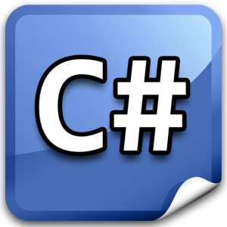
Running SQL Queries
There are many ways in which you can send queries to a SQL Server
Visual Studio Integrated Development Environment (IDE)
C# Application
SQL Query Analyzer
osql command prompt utility

Slide 10

Exercise
Working with SQL Queries

Slide 11
SELECT Statement
The SQL SELECT statement returns a result set of records from one or more tables
The SELECT statement has many optional clauses:
WHERE – specifies which rows to retrieve
GROUP BY – groups and aggregates rows by a sharing property
HAVING – selects among the groups defined by the GROUP BY clause
ORDER BY – specifies the order in which the rows are returned
AS – provides an alias, which can be used to temporarily rename tables or columns

Slide 12


INSERT Statement
The SQL INSERT statement is used to add one or more records to any single table in a relational database
Multiple rows can be inserted in a single SQL INSERT Statement

Slide 13





UPDATE and DELETE Statements
The SQL UPDATE statement changes the data of one or more records in a table
The SQL DELETE statement removes one or more records from a table

Slide 14
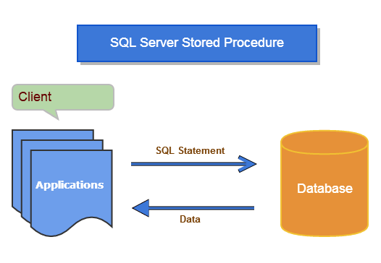
Stored Procedures

Slide 15

Stored Procedures
A Stored Procedure is a set of SQL statements that is stored in a database
Typical uses for stored procedures include
data validation (integrated into the database)
access control mechanisms

Slide 16

Exercise
Creating and Running Stored Procedures

Slide 17
Creating and Running Stored Procedures
(Working with Parameterized Stored Procedures)
(Working with Parameterized Stored Procedures)

Slide 18

Summary
What is SQL?
How to connect to a SQL Server Database?
What are the 4 main statements in SQL?
How to work with SQL queries?
What are Stored Procedures
Parameterized Stored Procedures
How to work with Stored Procedures?

Slide 19








Questions
https://softuni.bg/courses/javascript-applications/

